Slide 1
Goods & Services Tax

Slide 2
GST Registration
The turnover requirement for GST registration is $75,000 ($150k for non-profit organisations).
GST turnover is gross income minus GST.
It excludes: dividends, interest, distributions.
It is optional to register < $75,000, but if an entity anticipates it will exceed the threshold in current and future years it MUST register.

Slide 3
GST Reporting Periods
The GST reporting and payment cycle will be one of the following:
Monthly – if GST turnover is $20 million or more.
Quarterly – if GST turnover is less than $20 million
Annually – if voluntarily registered for GST. That is, the entity is registered for GST; and the GST turnover is under $75,000 ($150,000 for not-for-profit bodies).

Slide 4
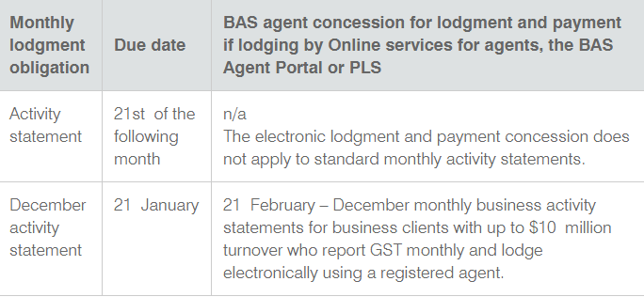
BAS Agent Lodgement and Payment Dates
Monthly

Slide 5
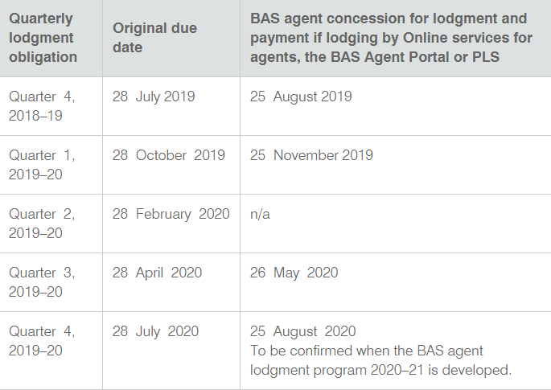
Quarterly

Slide 6
Annual
The date for lodgement of your annual GST return and payment of any amounts is either:
the date for lodgement of your income tax return
28 February following the annual tax period, if you are not required to lodge an income tax return.

Slide 7
Typical GST-Free or Input Tax Supplies
- bank fees and loan establishment fees
interest
council and water rates
rent and expenses for a domestic property
donations
government charges – ASIC fees, stamp duty
dividends and distributions
fines and penalties
some food items – bread, flour, cooking oil, unflavoured milk, spices, condiments, bottled drinking water, tea and coffee, fruit and vegetables, meat, breakfast cereals

Slide 8
Expenses that include GST
merchant fees
council and water rates on-charged by the agent
dealer origination fee for car finance
rent and expenses for a commercial property
WorkCover insurance premiums

Slide 9
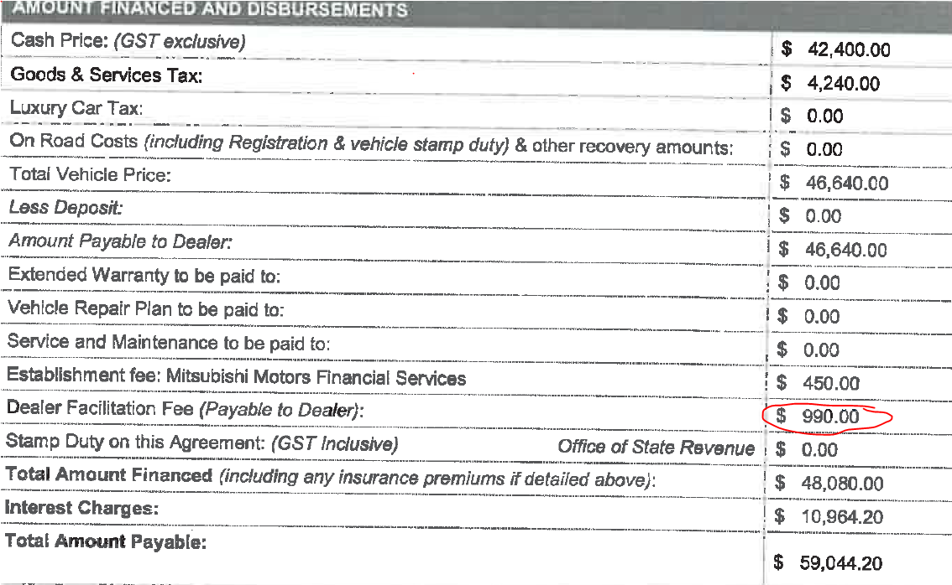

Slide 10
Expenses with GST and GST free Components
- motor vehicle registration
- insurance
- phone contract repayment of a telephone expense
Non-deductible expenses:
entertainment expenses 50/50 rule for FBT
private expenditure
When these expenses are not deductible for income tax the GST cannot be claimed

Slide 11
GST & the Depreciable Car Limit
If the purchase cost of the car is more that the car limit, the maximum amount is 1/11th of the limit.
For example, in 2018/19 the maximum GST credit you can claim is $5,234 (that is, 1/11th of $57,581)
When preparing the BAS, only the amount of the car limit (or proportion relating to business use) is shown at G10 – capital expenditure.

Slide 12
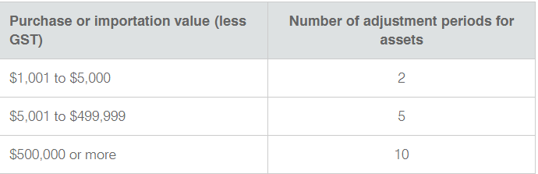
GST Cancellation and Adjustments
If the GST registration is cancelled and there are business assets that have claimed GST credits, an adjustment may need to be made in the final BAS.
The time period for these adjustments is:
The formula for calculating the adjustment is:
Market value of asset immediately before cancellation of GST x business use percentage / 11

Slide 13
Cash vs Accrual
GST can be calculated using the cash or accrual method
Cash method
business with aggregated turnover of less than $10 million or use cash accounting
GST is calculated on income and expenses when cash has been paid or received
Accrual method
GST is calculated when invoices are issued or received
GST Reconciliation
If a client’s GST is calculated on cash but the financial statements are calculated on accrual, a GST reconciliation needs to be prepared to split the cash GST from the accrued GST.

